Slide 1
Intramurals Scheduling
(Bipartite Matching Algorithm)
Satish Parajuli, Mradul Mourya, Michael Lie
CS 473

Slide 2
Problem Explained……
U-Rec has been struggling with creating optimal schedules where each intramural teams can match with one other team and play at least 1-2 times a week.
By using Bipartite Matching Algorithm, we can find the best optimal solution to find the optimal pair solutions
Data are stored in through CSV files that is receive from quadratics survey

Slide 3
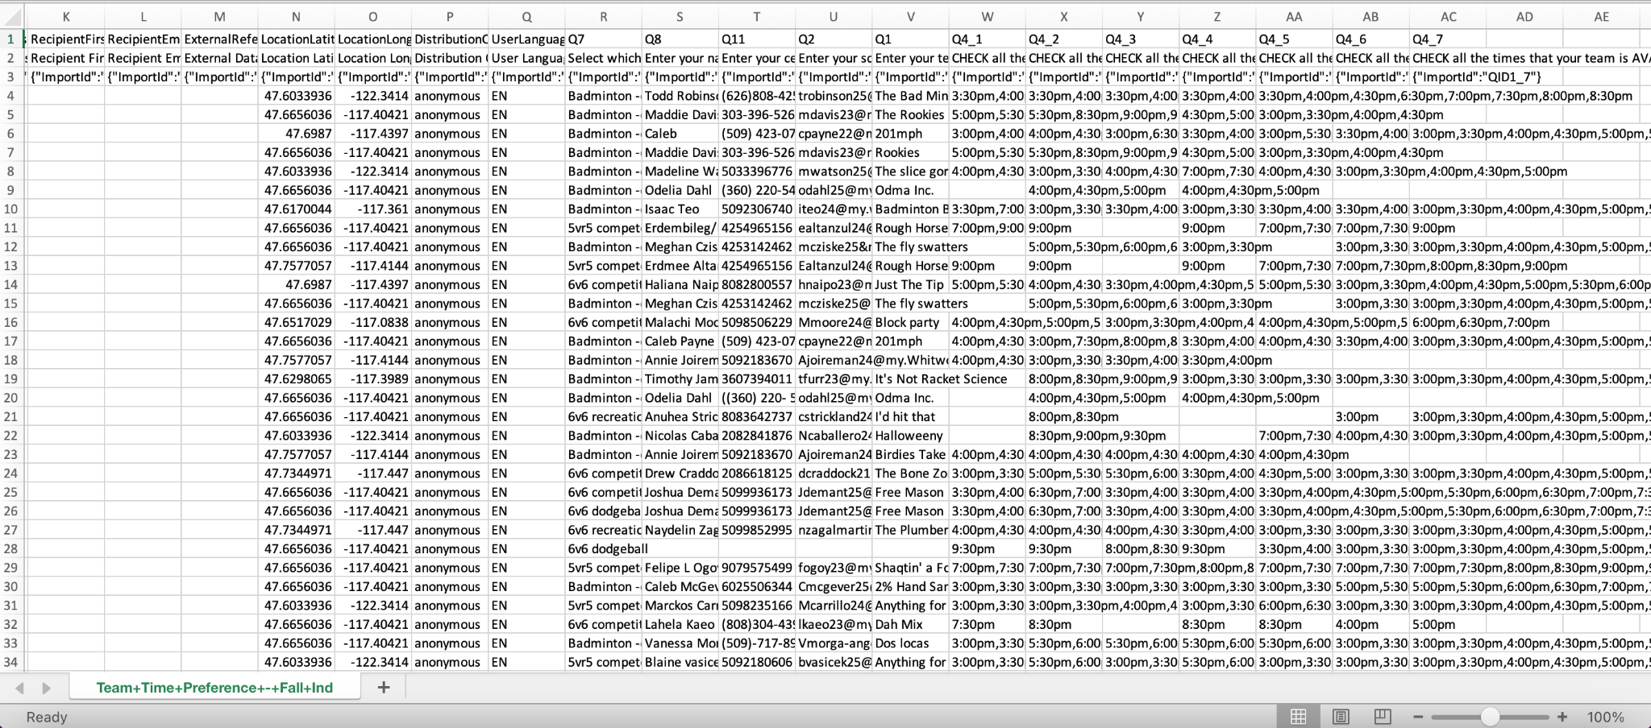
This is how the original (qualtrics) data looks like

Slide 4
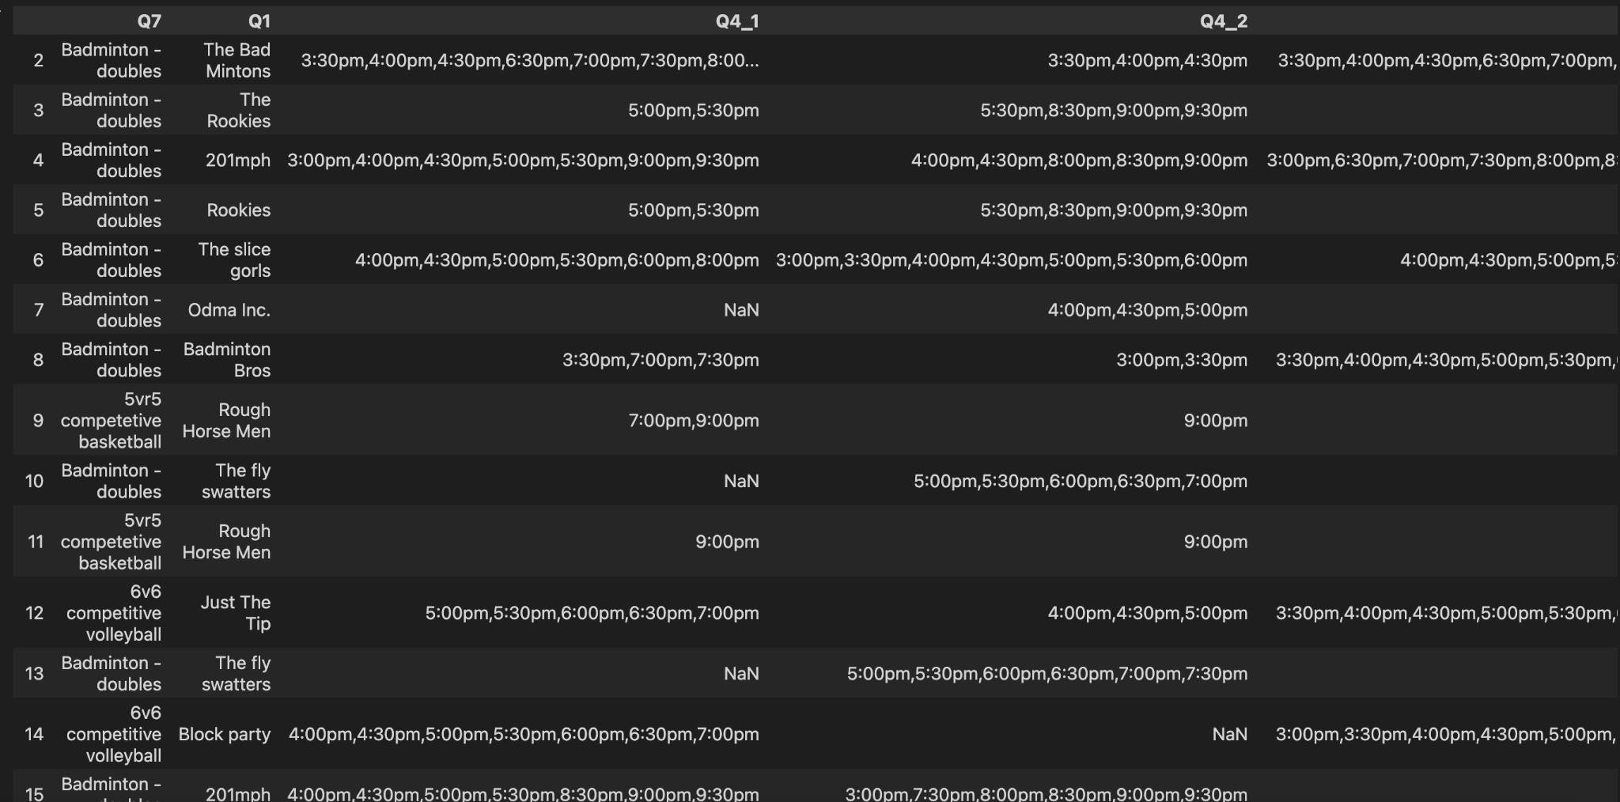
The things in the data that we’re concerned with

Slide 5
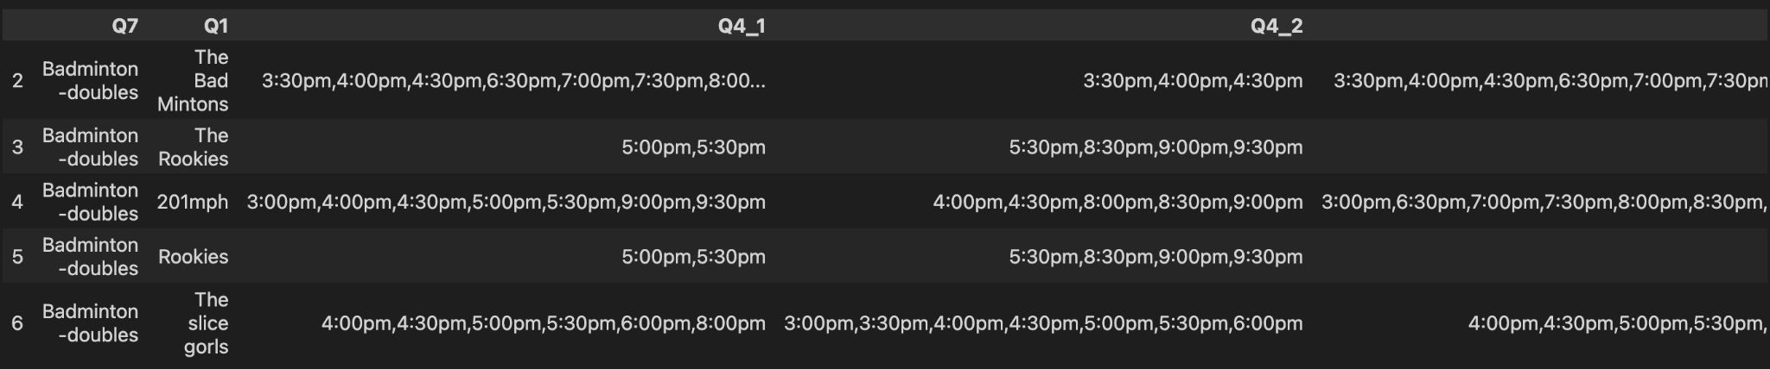
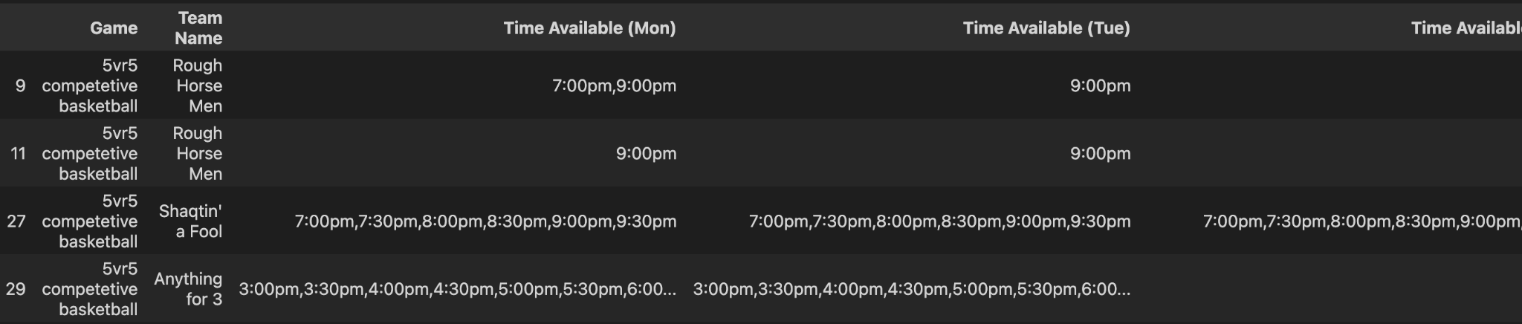
Making data frames grouped by games

Slide 6
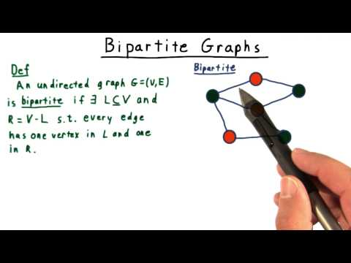
Algorithm Explained……
But before that, what really is a Bipartite graph?

Slide 7
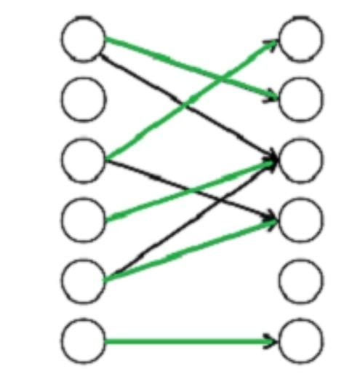
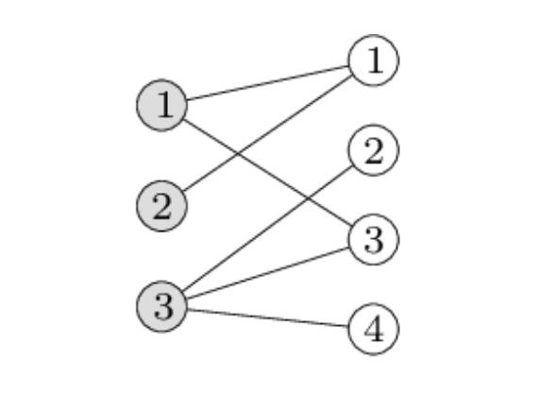
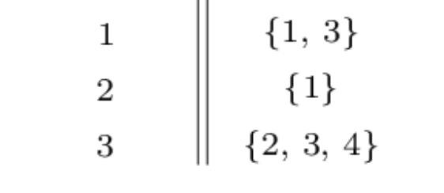
Algorithm Explained (continued)……
A matching in a Bipartite Graph is a set of the edges chosen in such a way that no two edges share an endpoint. A maximum matching is a matching of maximum size (maximum number of edges). In a maximum matching, if any edge is added to it, it is no longer a matching. There can be more than one maximum matchings for a given Bipartite Graph.

Slide 8
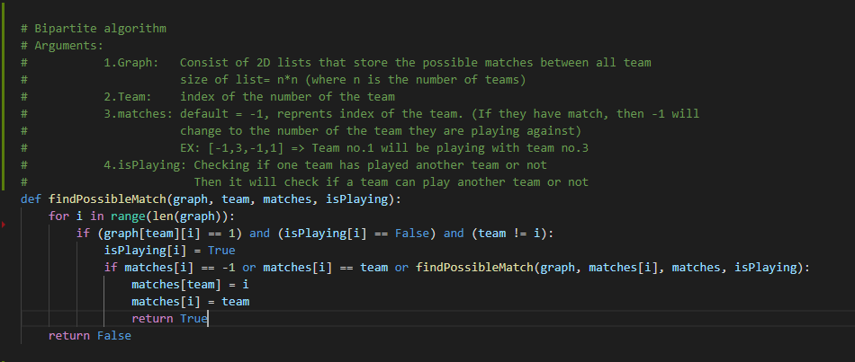
Bipartite Matching algorithm

Slide 9
Challenges encountered
Coming up with an optimal algorithm (required a lot of brainstorming and Prof. Kent’s help).
Making sure that code should work for the future data as well so that U-rec can utilize it for other competitions too (as long as data is in the same format).
Making program efficient (with less use of loops to decrease time complexity).
Multiple errors occur whenever there is NULL values (which we solved).

Slide 10
Code walkthrough!!!!!!!

Slide 11
Questions?

